Slide 1



Gym Management System
Web Application for Gym Administration & Members
Presented by: Abhay Parmar

Slide 2
Introduction
Purpose: Streamline gym operations like member registration, billing, diet plans, and supplement tracking.
Roles: Admins, Members, and General Users

Slide 3
Features
Admin Panel: Manage members, billing, notifications, supplements, and diet plans.
Member Portal: View bills, notifications, profile updates.
User Portal: View gym info, facilities, operating hours, personal records.
Authentication: Login/Registration with roles (Admin, Member, User)

Slide 4
Technology Stack
Frontend: HTML, CSS, JavaScript
Backend/Database: Firestore Firebase
Authentication: Firebase Auth

Slide 5
System Architecture
Clients: Admin, Member, User
Firebase: Auth, Firestore, Storage
Real-time Notifications using Firestore
Role-based routing and data access

Slide 6
Admin Module
Add/View/Edit/Delete Members
Create and Manage Bills
Send Notifications (Selected Members)
Manage Supplements and Diet Plans

Slide 7
Member Module
View Bills and Notifications
Update Personal Profile
View Member Details

Slide 8
User Module
View Gym Information (Contact, Hours, Facilities)
Read Announcements
Track Personal Records (Activity Logs)

Slide 9
Authentication Workflow
Login and Registration with Role Selection
Session Management using Firebase Auth
Role-Based Redirection to Dashboards

Slide 10
Firebase Integration
Configured in firebase-config.js
Functions: addMember, addBill, addNotification, addSupplement, addDietPlan,addUser
Firestore collections

Slide 11
Conclusion
Simplifies gym operations and enhances user experience
Real-time updates and cloud storage
Future improvements: Payment integration, Analytics dashboard, Mobile App

Slide 12
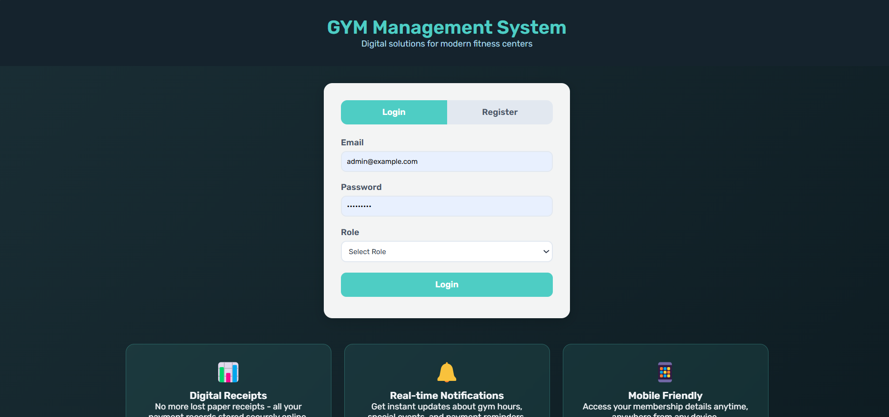
Login Page
User selects role and logs in securely.
User can be easily Register.

Slide 13
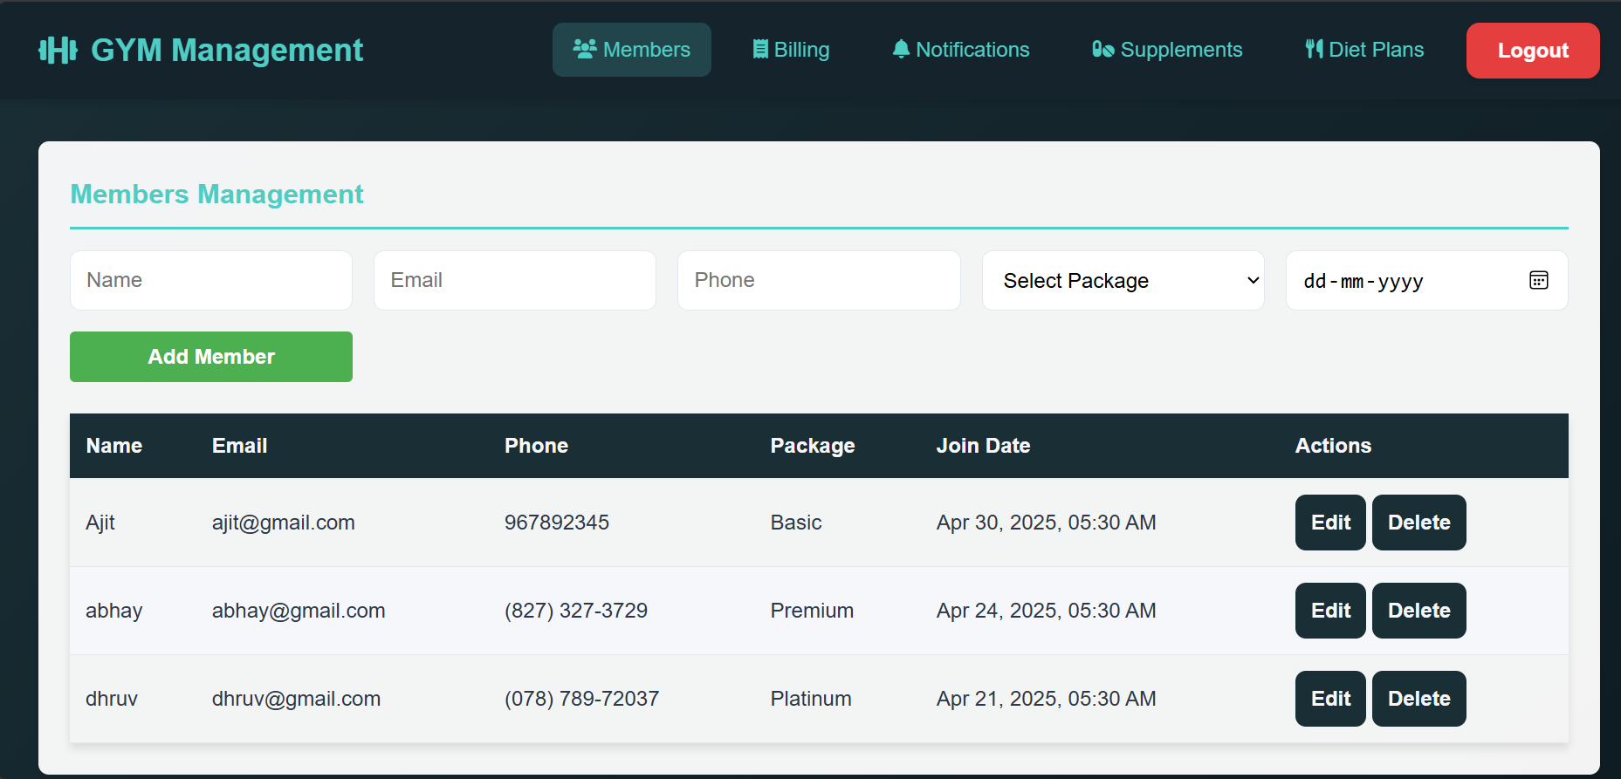
Admin Dashboard
Manage Members, Add Member, select Package etc.
Logout functionality with session handling

Slide 14
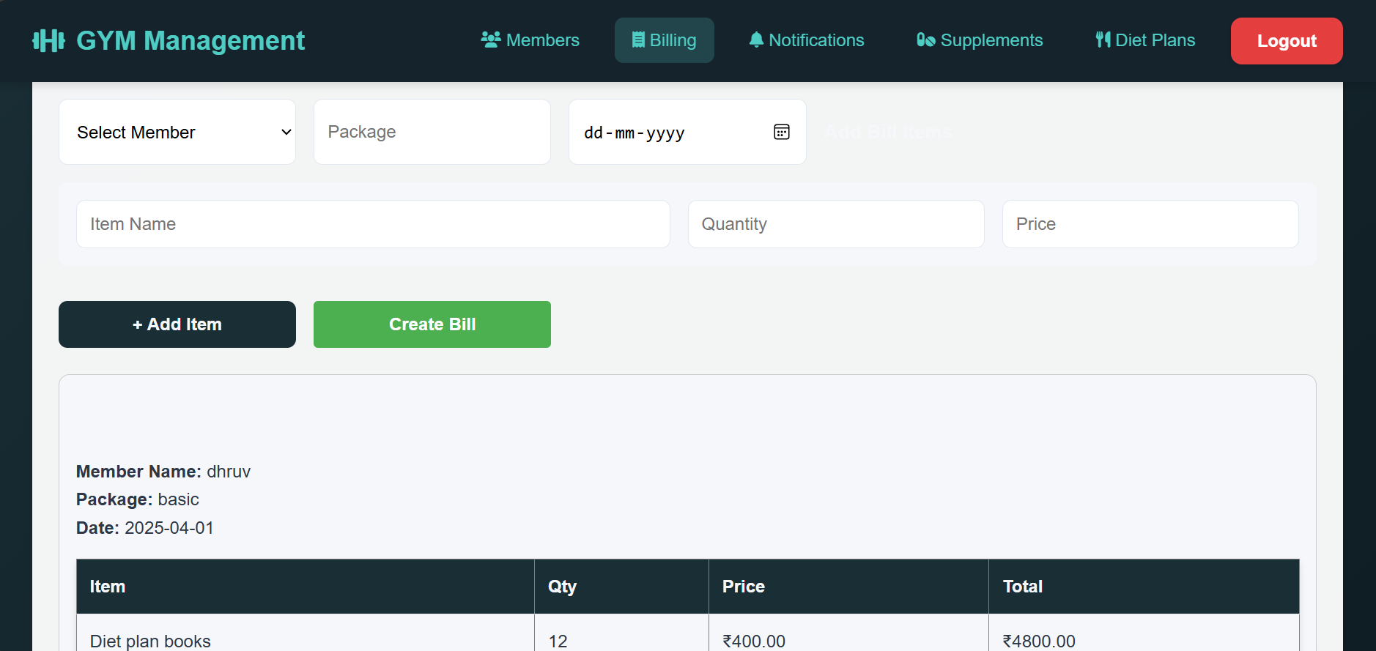
Admin Dashboard
Dynamic calculation of total amount.
Generates a detailed bill summary, viewable immediately on-screen.

Slide 15
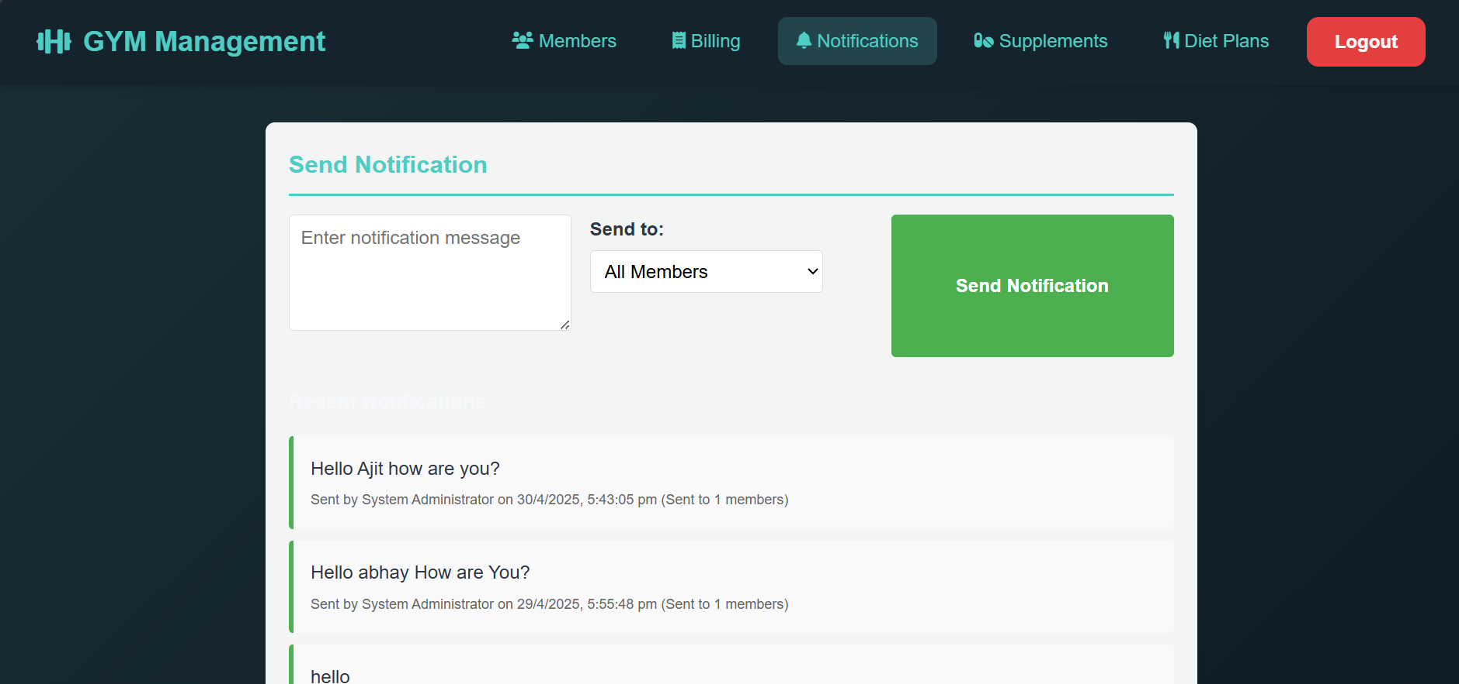
Admin Dashboard
Types of Notification
💸 Billing reminders and Event alerts
📢 Announcements and Class updates etc.

Slide 16
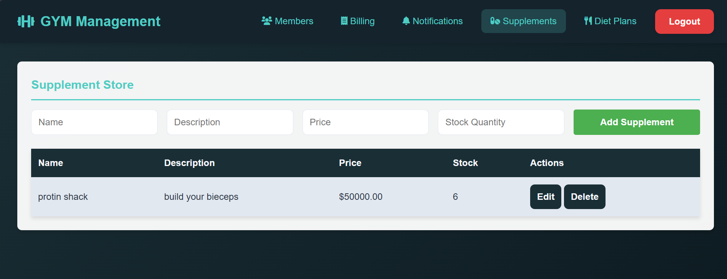
Admin Dashboard
Product details include:
🏷 Name and 📄 Description
💵 Price and 📦 Stock quantity

Slide 17
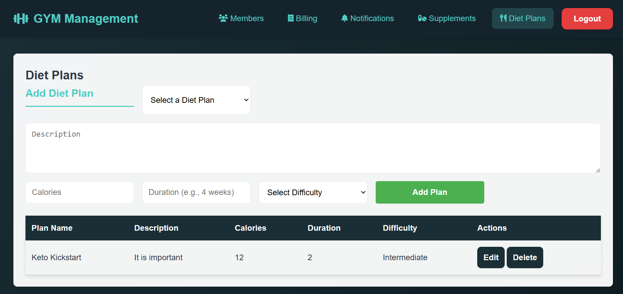
Admin Dashboard
Admins can create and manage customized diet plans
Each diet plan includes: Plan Name, Description, Calories, Duration (e.g., 4 weeks),Difficulty Level (Beginner ,Intermediate, Advanced) etc.

Slide 18
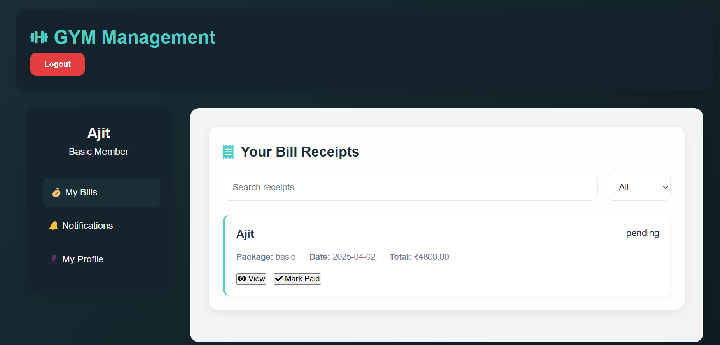
Member Profile
Manage Members, Add Member, select Package etc.
Logout functionality with session handling

Slide 19
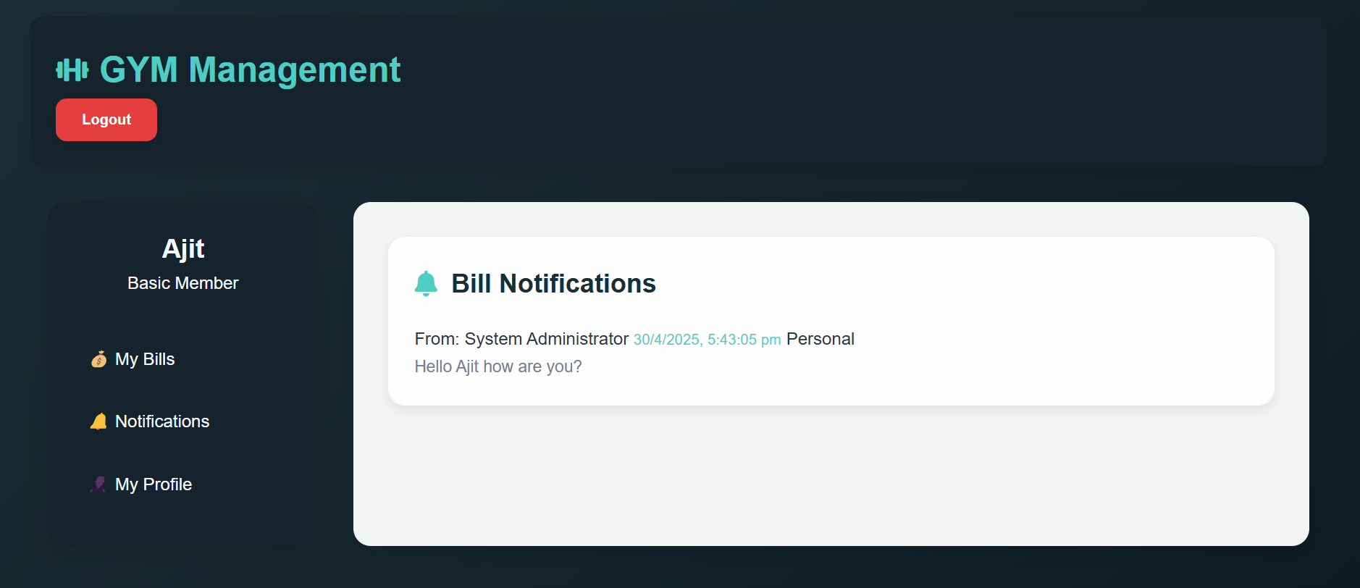
Member Profile
Accessible via the "Notifications" tab in the sidebar.
Members receive real-time notifications sent by Admins.

Slide 20
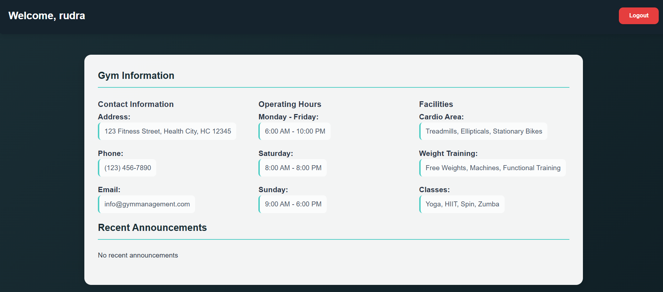
User Info Page
Shows Gym Information like:
📍 Address and 📞 Contact Details
🕒 Operating Hours for weekdays and weekends.

Slide 21
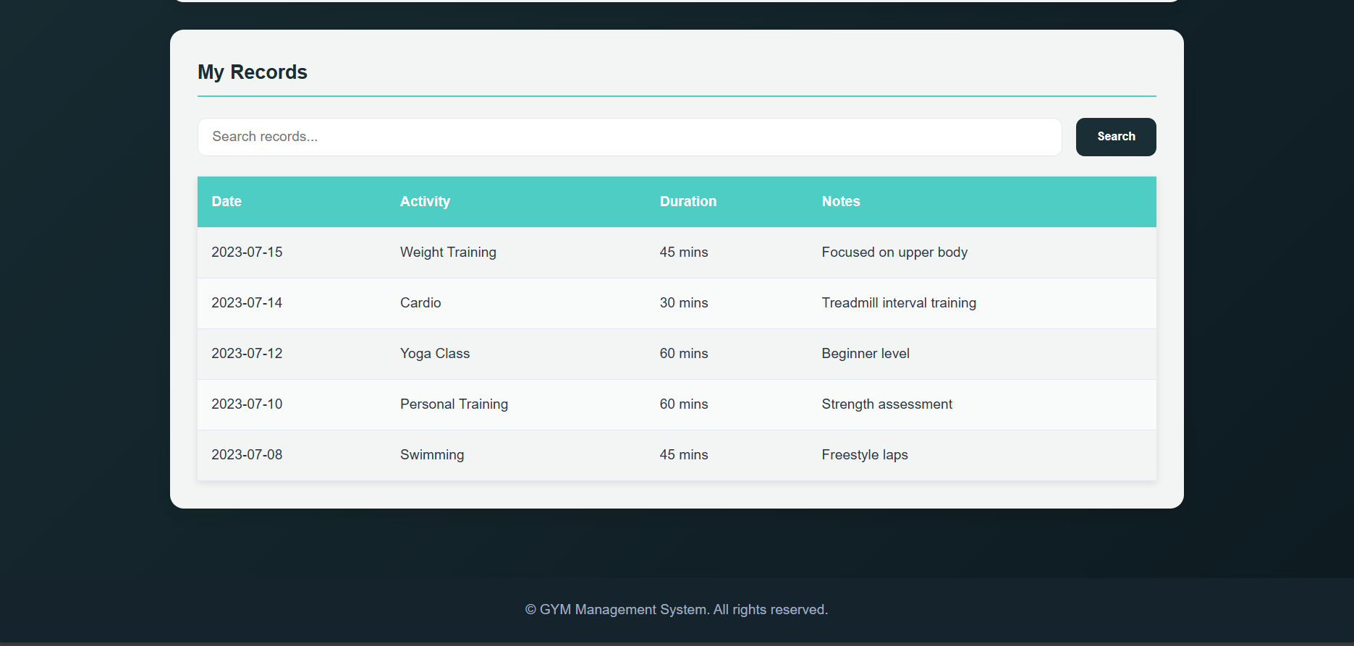
User Info Page
Log and view personal fitness activities.
Track date, duration, type, and notes of each workout.

Slide 22
GitHub & Live Demo
🔗 GitHub: AbhayMParmar/Gym-Management-System
🚀Live Site:GYM Management System - Login

